Slide 1
Data Wrangling

Slide 2
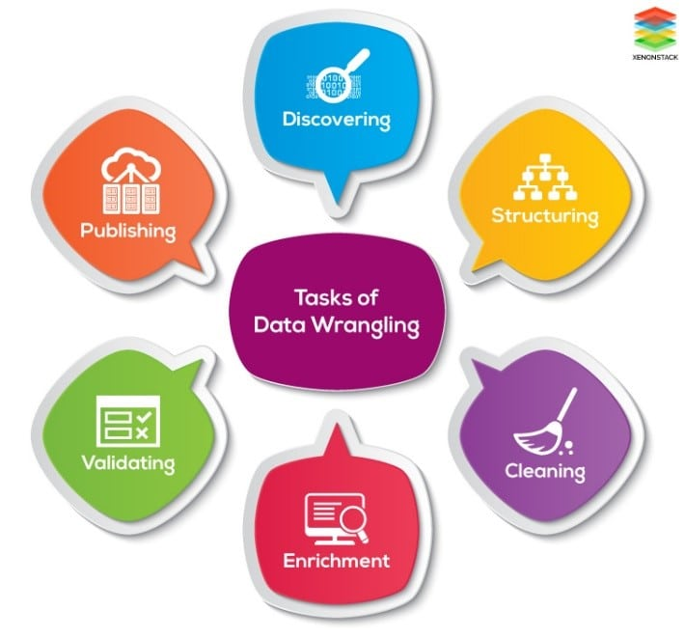
Data Wrangling
Data wrangling, sometimes referred to as data munging, is the process of transforming and mapping data from one "raw" data form into another format with the intent of making it more appropriate and valuable for a variety of downstream purposes such as analytics.

Slide 3
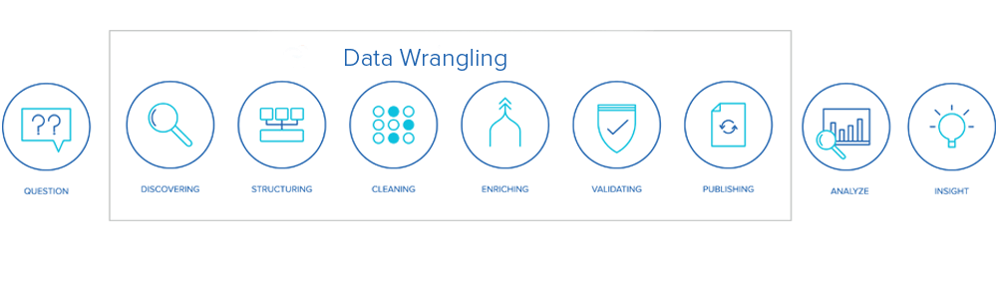
Data Wrangling Tasks

Slide 4
A. Discovering
Discovery refers to the process of familiarizing yourself with data so you can conceptualize how you might use it.

Slide 5
A. Discovering
During discovery, you may identify trends or patterns in the data, along with obvious issues, such as missing or incomplete values that need to be addressed.

Slide 6
A. Discovering
This is an important step, as it will inform every activity that comes afterward.

Slide 7
B. Structuring
The data structuring step, sometimes called data transformation, focuses on organizing the data into a unified format so that it is suitable for analysis.

Slide 8
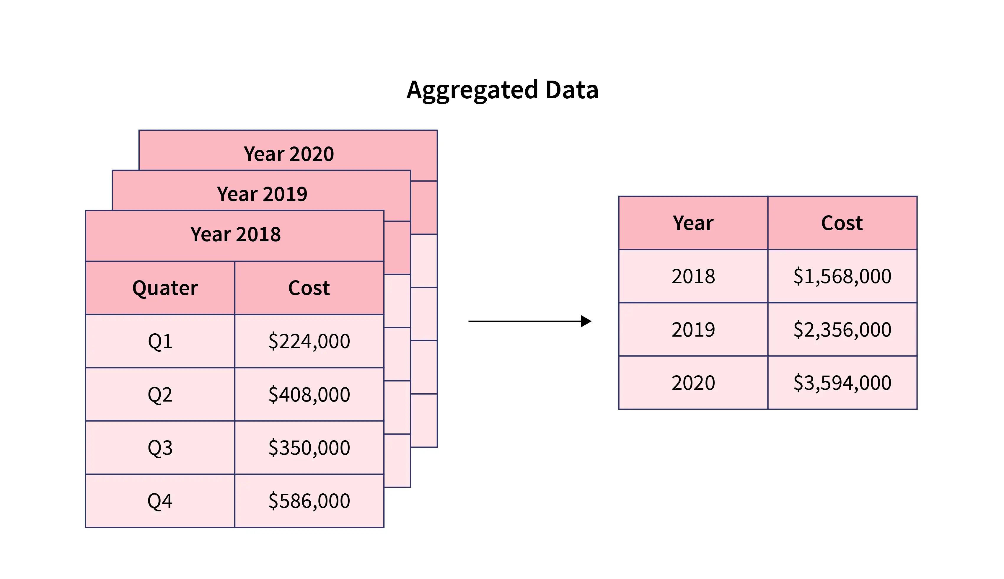
B. Structuring
Aggregation: Combining rows of data by using summary statistics and grouping data based on certain variables.

Slide 9
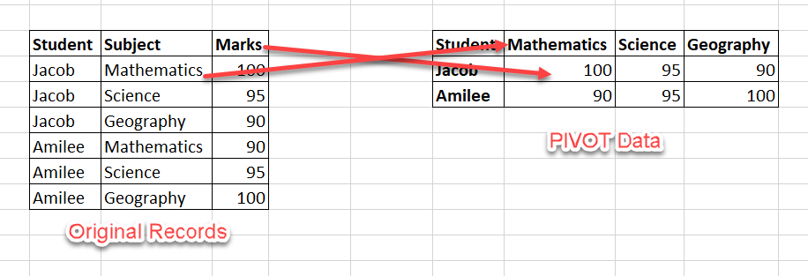
B. Structuring
Pivoting: Shifting data between rows and columns or transforming data into other formats to prepare it for use.

Slide 10
B. Structuring

Slide 11
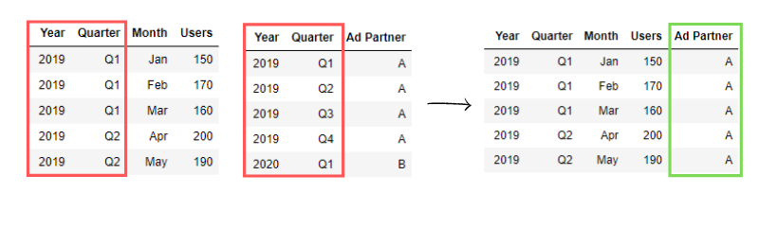
B. Structuring
Joining: Combining data from multiple tables and combining related information from disparate sources.

Slide 12
B. Structuring

Slide 13
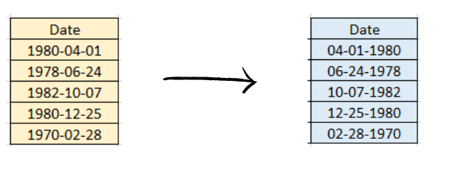
B. Structuring
Data type conversion: Changing the data type of a variable to aid in performing calculations and applying statistical methods.

Slide 14
B. Structuring

Slide 15
C. Cleaning
Data cleaning involves handling missing values, removing duplicates and correcting errors or inconsistencies.

Slide 16
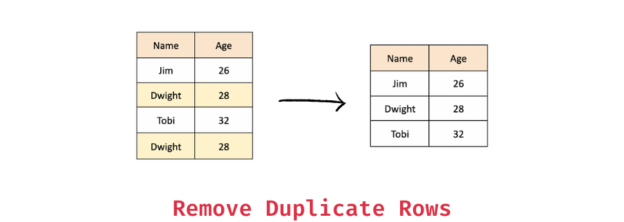
C. Cleaning

Slide 17
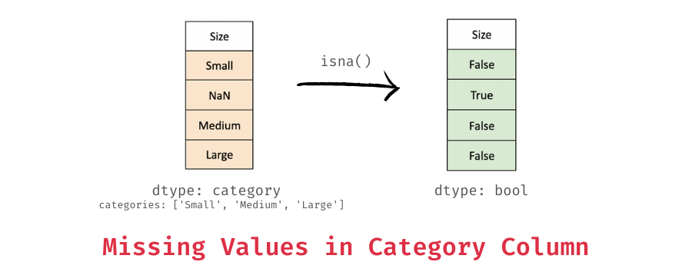
C. Cleaning

Slide 18
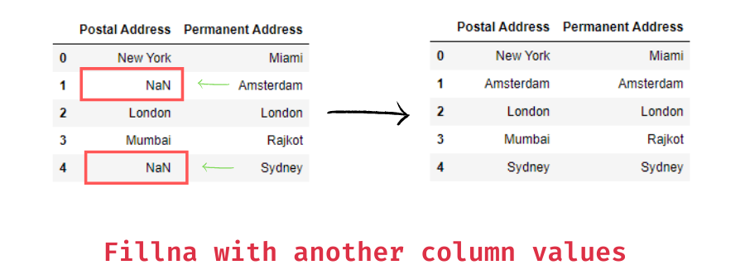
C. Cleaning

Slide 19
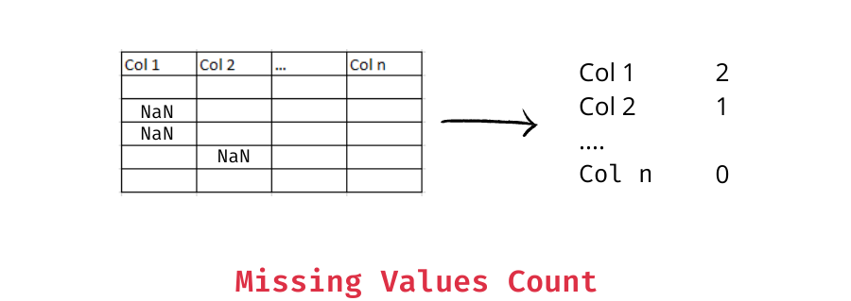
C. Cleaning

Slide 20
D. Enriching
Data enrichment involves adding new information to existing data sets to enhance their value. Sometimes called data augmentation

Slide 21
D. Enriching
It involves assessing what additional information is necessary and where it might come from.

Slide 22
D. Enriching
Then, the additional information must be integrated with the existing data set and cleaned in the same ways as the original data.

Slide 23
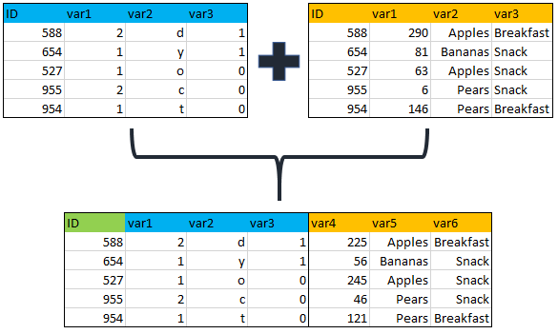
D. Enriching
Merging data from multiple sources to develop a more comprehensive dataset.

Slide 24
D. Enriching
Creating new features from existing data that can provide additional insights when analyzed.

Slide 25
D. Enriching
Feature creation involves generating new features from domain knowledge or by observing patterns in the data.

Slide 26
D. Enriching
It can be:
Domain-specific: Created based on industry knowledge like business rules.
Data-driven: Derived by recognizing patterns in data.
Synthetic: Formed by combining existing features.

Slide 27
E. Validating
This step involves verifying the accuracy and consistency of the wrangled data. First, validation rules must be established based on business logic, data constraints and other issues.

Slide 28
E. Validating
Data type validation: Helping ensure correct data types.
Range or format checks: To verify values fall within acceptable ranges and adhere to certain formats.
Consistency checks: Making sure that there is a logical agreement between related variables.

Slide 29
E. Validating
Uniqueness checks: Confirming that certain variables (such as customer or product ID numbers) have unique values.
Cross-field validation: Checking for logical relationships between variables (for example, age and birthdate).
Statistical analysis: Identifying outliers or anomalies by using descriptive statistics and visualizations.

Slide 30
F. Publishing
Once your data has been validated, you can publish it. This involves making it available to others within your organization for analysis.

Slide 31
References
https://online.hbs.edu/blog/post/data-wrangling
https://www.ibm.com/think/topics/data-wrangling

